Slide 1
Ryan Thompson Mini Project

Slide 2
My Topic: Detecting Credit Card Fraud

Slide 3
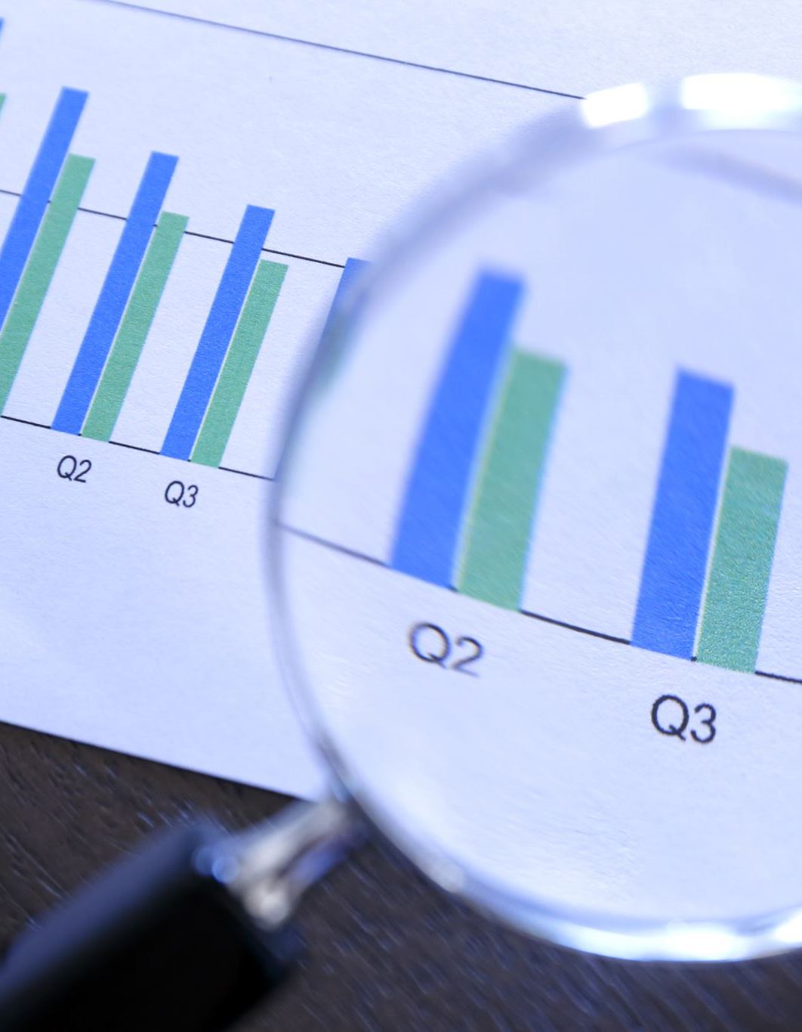
Why I Chose this Topic
I’ve always found digital forensics to be extremely interesting, and a big reason why I got into data analytics in the first place.
For my job next year, I will be working for a Consulting firm, inn the Data Analytics - Forensics and Litigation sector.
Detecting fraud and working with cybersecurity will be a large part of my day to day, so I felt it’d be a great idea to base my project around it.

Slide 4
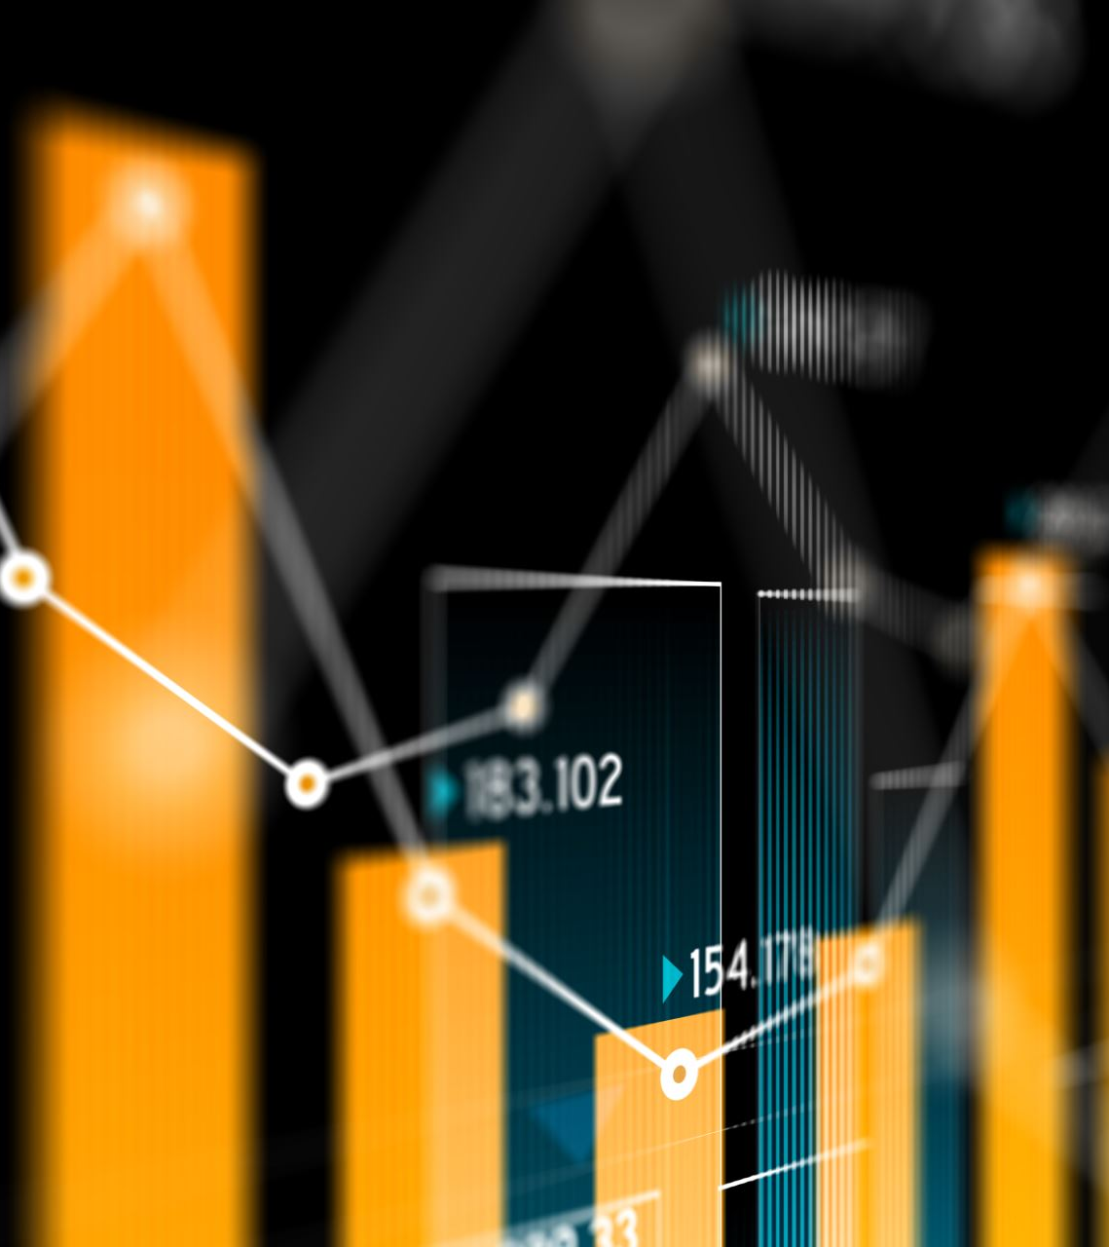
My Data
This dataset was imported from Kaggle.
It contains transactions from Jan 1, 2019 until Dec 30, 2020.
It contains a mix of both fraudulent and legitimate transactions, depicted by a binary column with 1 representing fraud and 0 representing legitimate.
The dataset also includes columns depicting transaction date/time, transaction amount, transaction type, cardholder info, location, industry of purchase, etc.

Slide 5
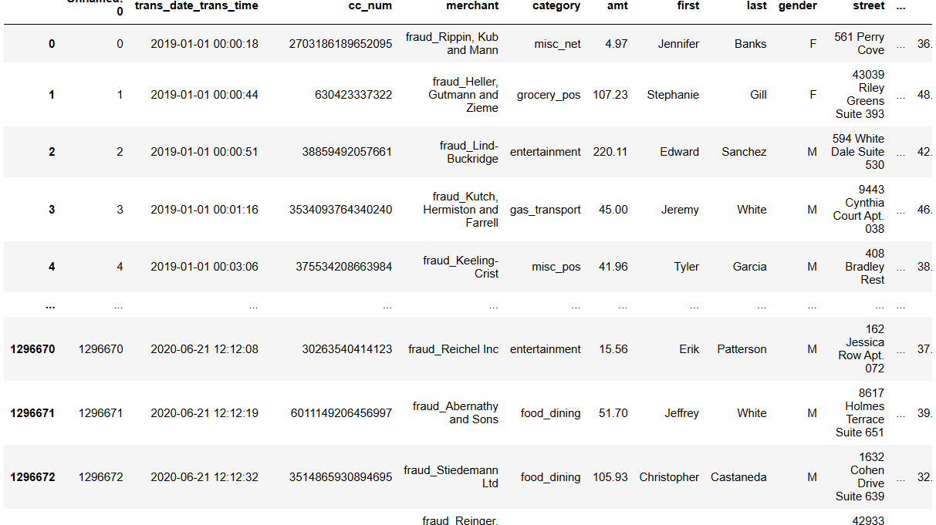

Slide 6
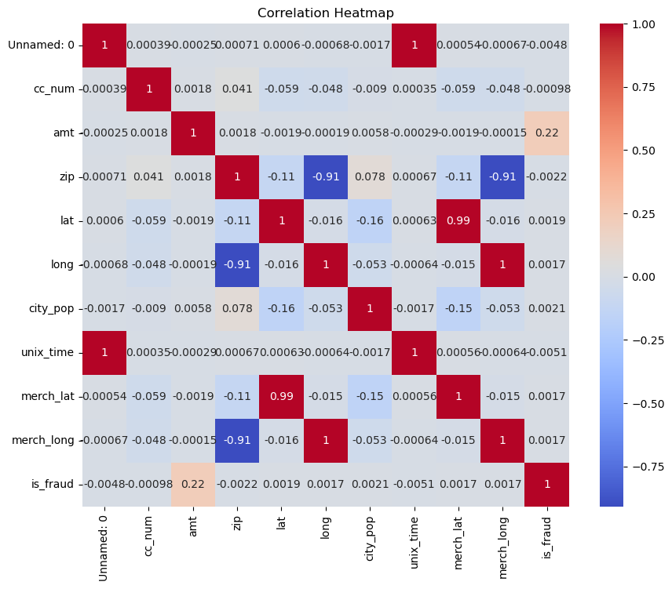
Exploratory Data Analysis

Slide 7
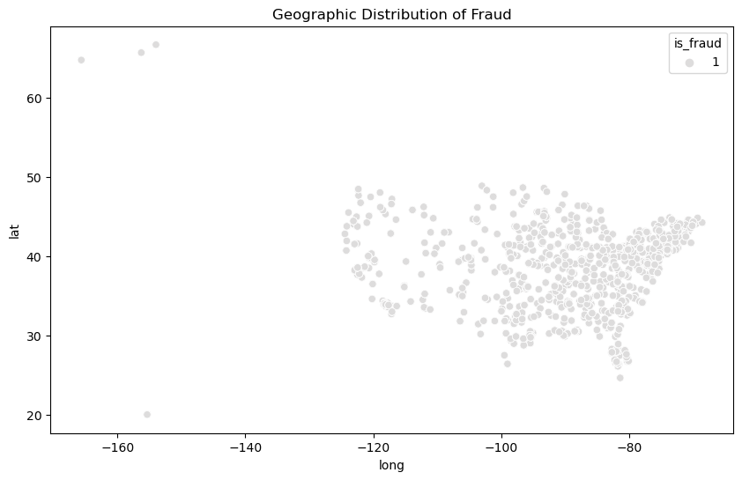
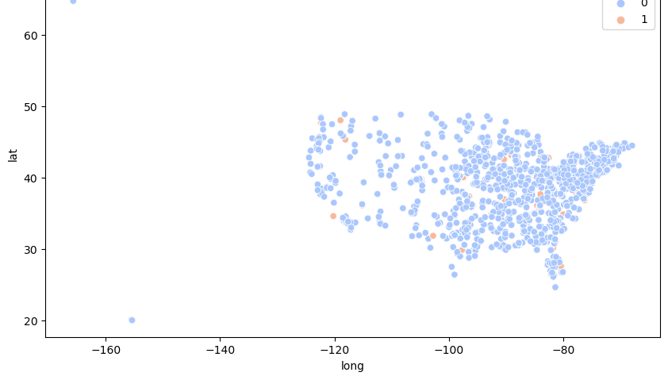

Slide 8
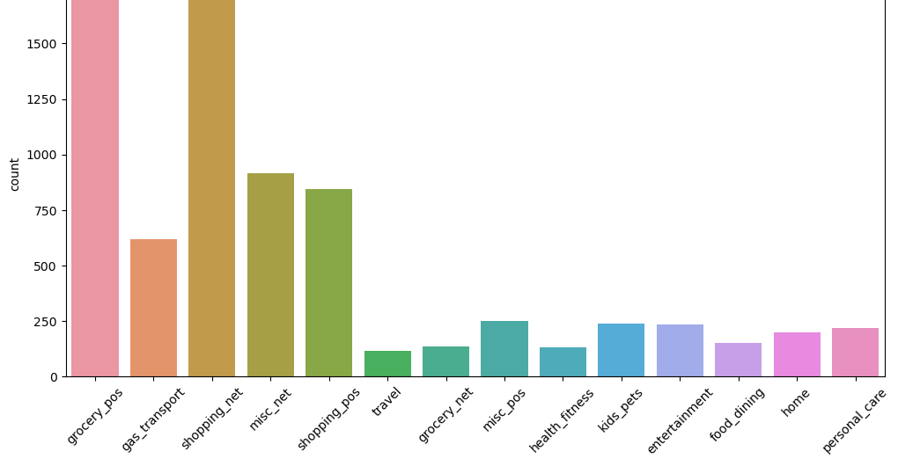

Slide 9
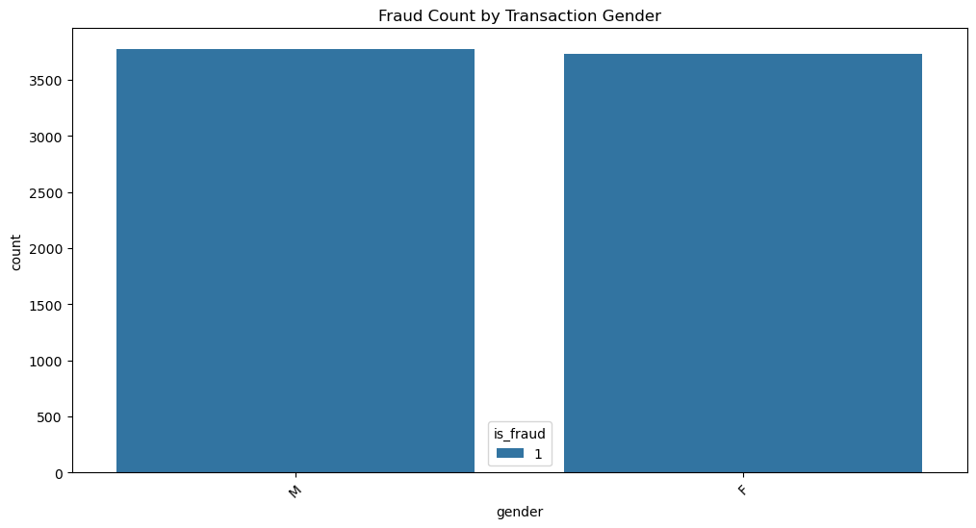

Slide 10
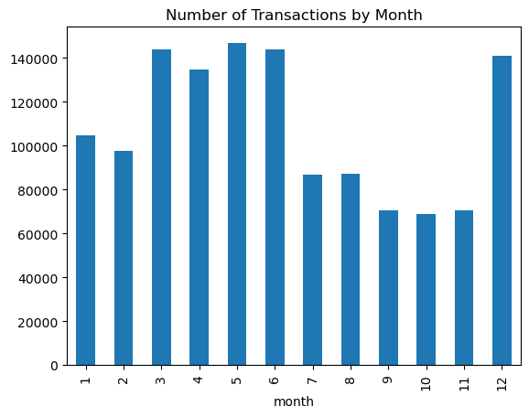

Slide 11
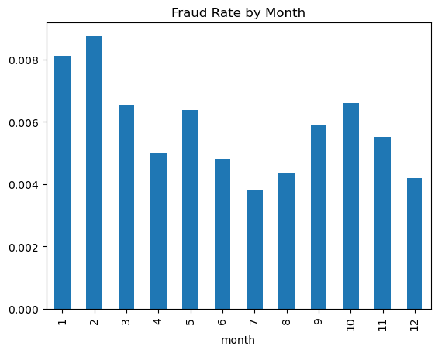

Slide 12
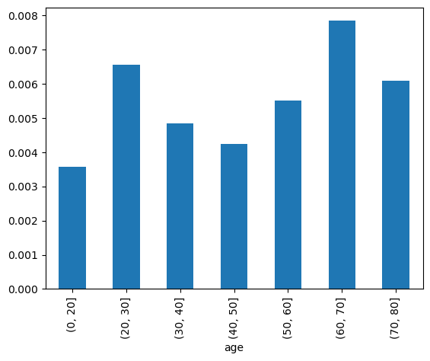

Slide 13
Findings
From initial analysis, the fraud is concentrated towards major cities/Northeast.
Grocery shopping and leisure shopping are the two highest categories for fraud.
There is little discrepancy between Male and Female Card Holders.
December and March – July were top months for fraud.
Older people are more susceptible to fraud.

Slide 14

Models I plan on using
CatBoost
Works well for data with lots of categorical variables.
Linear Regression
Need to use encoding for categorical variables
Would also need to balance out data, as it has too many legitimate transactions

Slide 15
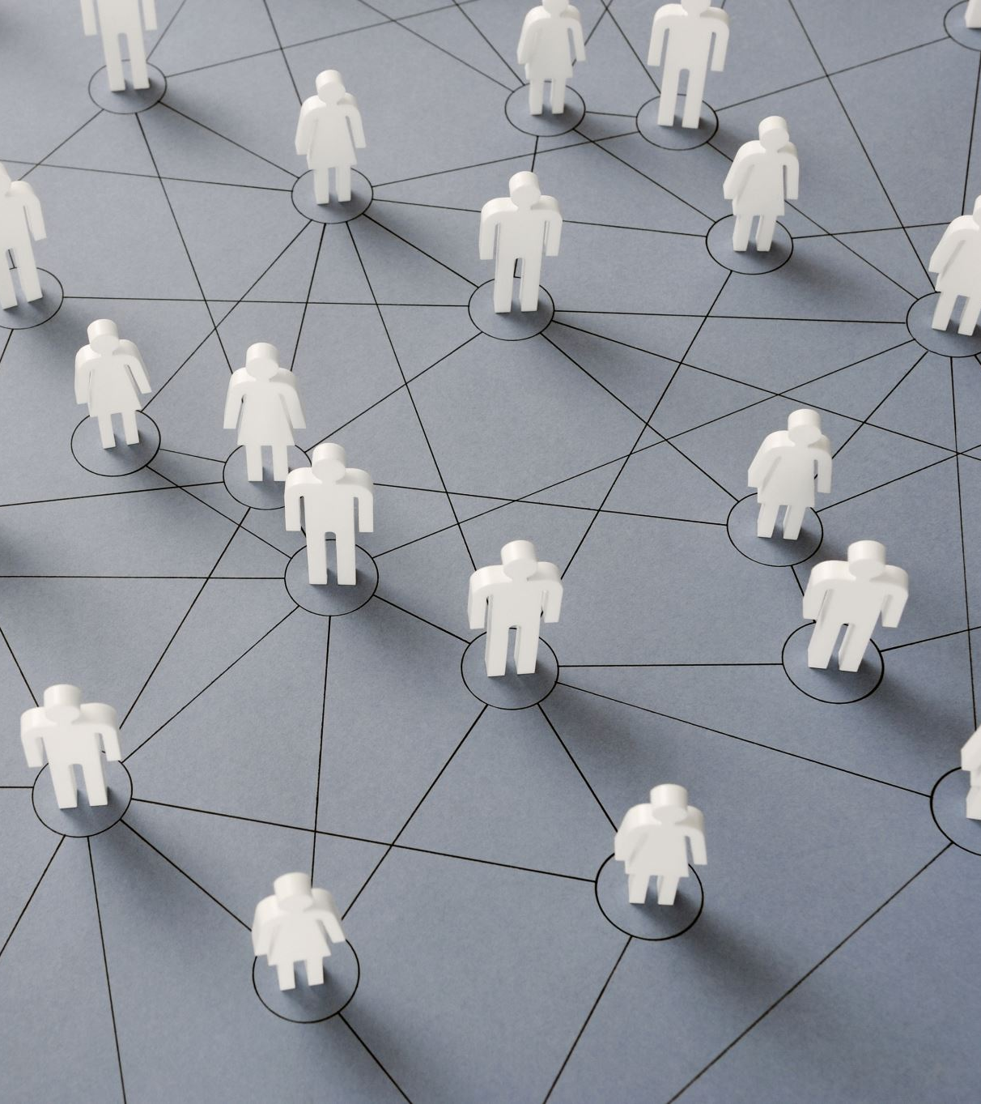
Implications for Stakeholders
Stakeholders would have a vested interest in this project.
Business Stakeholders (Banks) would see reduced fraud losses, improved customer trust, and a decrease in operational costs.
Customers/Consumers would feel more secure when making transactions, and there would be less disputing of charges.
Data Science and IT teams would need to make sure that the model is working properly and effectively for their company.
Regulatory teams would need to make sure it follows the law.

Slide 16
Societal/Ethical Concerns
Privacy and Data Protection
Any type of breach could put vital customer information at risk
There will be a lot of important, personal information put into the hands of a model or a data scientist
Bias within the Model:
The model could flag disproportionately for certain gender or ethnic groups.
The model could look at historical data and create bias.
Geographical modeling could unfairly target certain groups as well.

